Slide 1
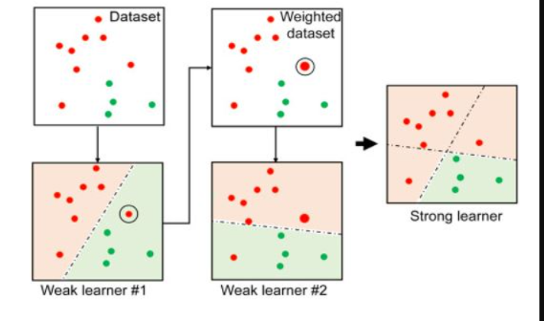
Ada boost Algorithm AdaBoost (short for Adaptive Boosting) is an ensemble learning technique that combines multiple weak learners (usually decision trees) to create a strong learner.

Slide 2
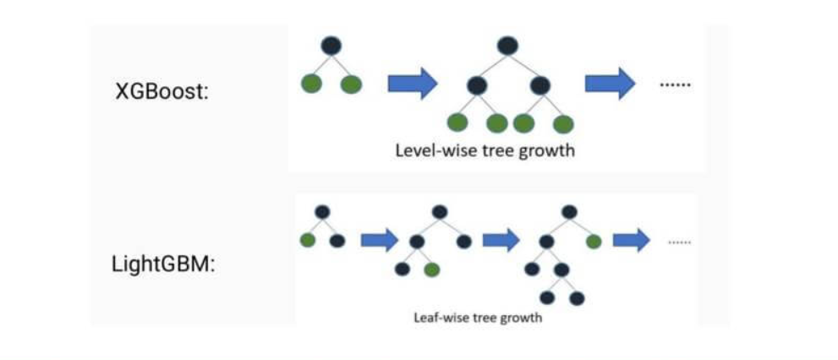
XG boost Algorithm XGBoost is an open-source library that provides an efficient and effective implementation of the gradient boosting algorithm. XGBoost, short for eXtreme Gradient Boosting, is a powerful distributed machine learning algorithm known for its efficiency, speed,cache optimaization,parallezation and accuracy hhh

Slide 3
LG boost algorithm
It’s based on decision trees and constructs a strong learner by sequentially adding weak learners (trees) in a gradient descent manner.
It handles largest dataset by leave wise grow method.
It uses histogram based method for selecting best fit.

Slide 4
# Initialize the adaboosting regressor
class sklearn.ensemble.AdaBoostRegressor(estimator=None, *, n_estimators=50 , random_state=None)
# Initialize the gradient boosting regressor reg = ensemble.GradientBoostingRegressor(**params) #Set the model parameters params = { "n_estimators": 500, "max_depth": 4, "min_samples_split": 5, "learning_rate": 0.01, "loss": "squared_error", # Use least squares loss }

Slide 5
XG boost Algorithm

